Slide 1
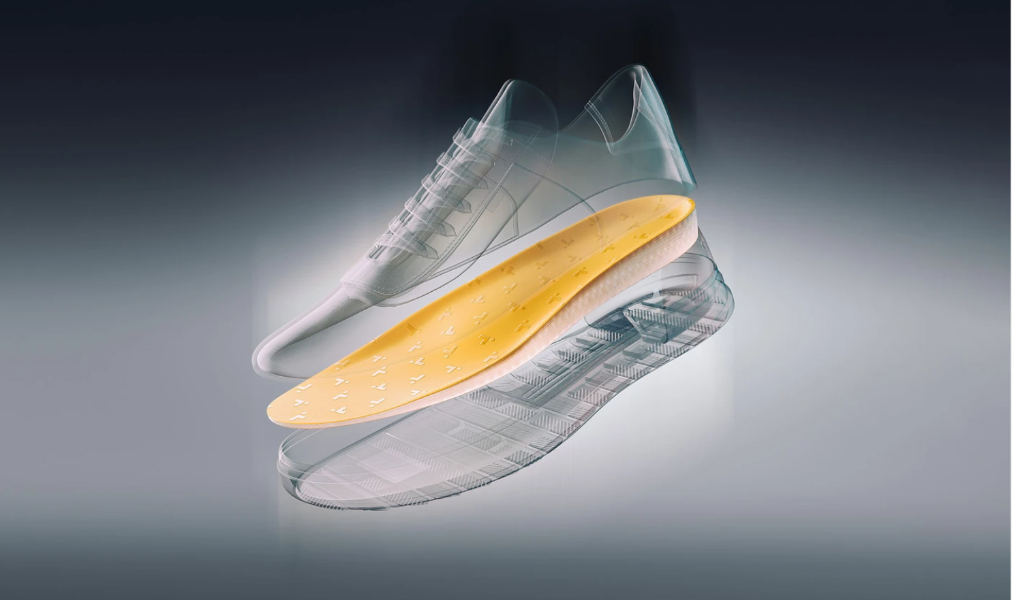
CASCA
SmartFit QC
Final Presentation
March 31st, 2021

Slide 2
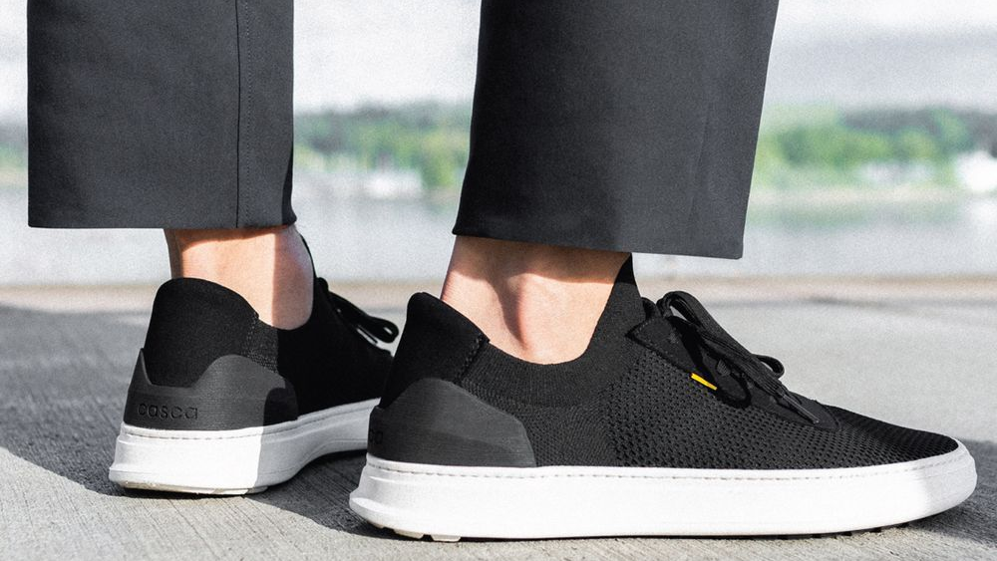
Project Refresher
Notes:
Alex

Slide 3



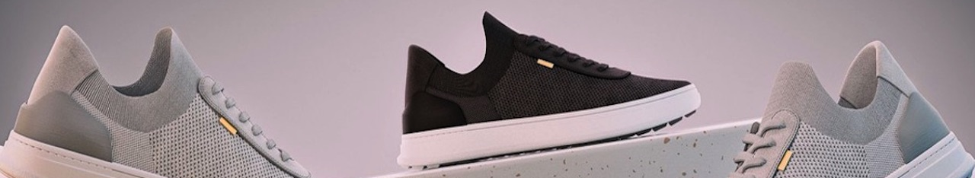
Project Objectives
Develop and build an autonomous quality control rig
Perform quantitative quality control
Integrate with Casca’s internal systems and databases
Notes:
Alex

Slide 4

Casca Production Process Overview
Customer orders insole
Fitter custom fits insole to foot scan
Insole is printed
Visual quality control
Quantitative quality control
Top sheet is glued
Top sheet is trimmed
Insole is shipped
Notes:
Alex

Slide 5



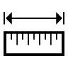



(New) Quality Control Process Overview
Read the QR Code
Fetch insole data
Perform Quantitative Analysis*
Compare to expected values
Update Database
Display results
* The quantitative analysis contains many quantitative visual and physical tests. These include compression testing, size validation, profile validation and weight validation. They will be discussed later in the presentation
Notes:
Alex

Slide 6
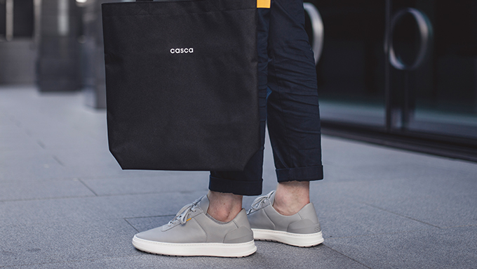
Rig Structure and Sensors

Slide 7
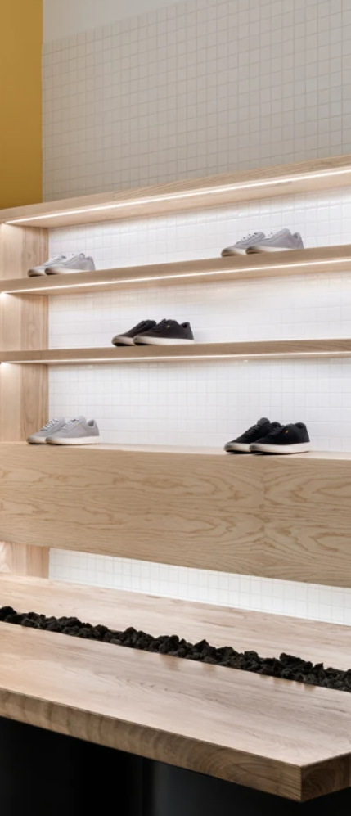
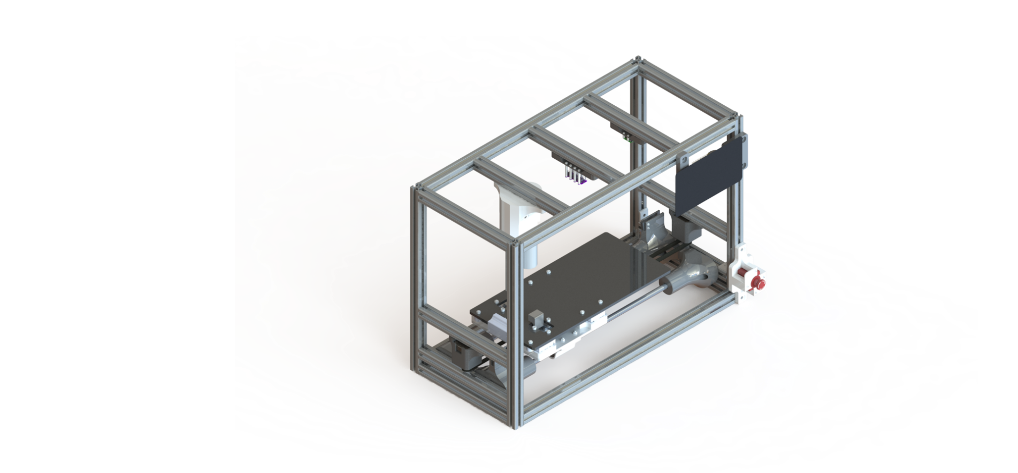
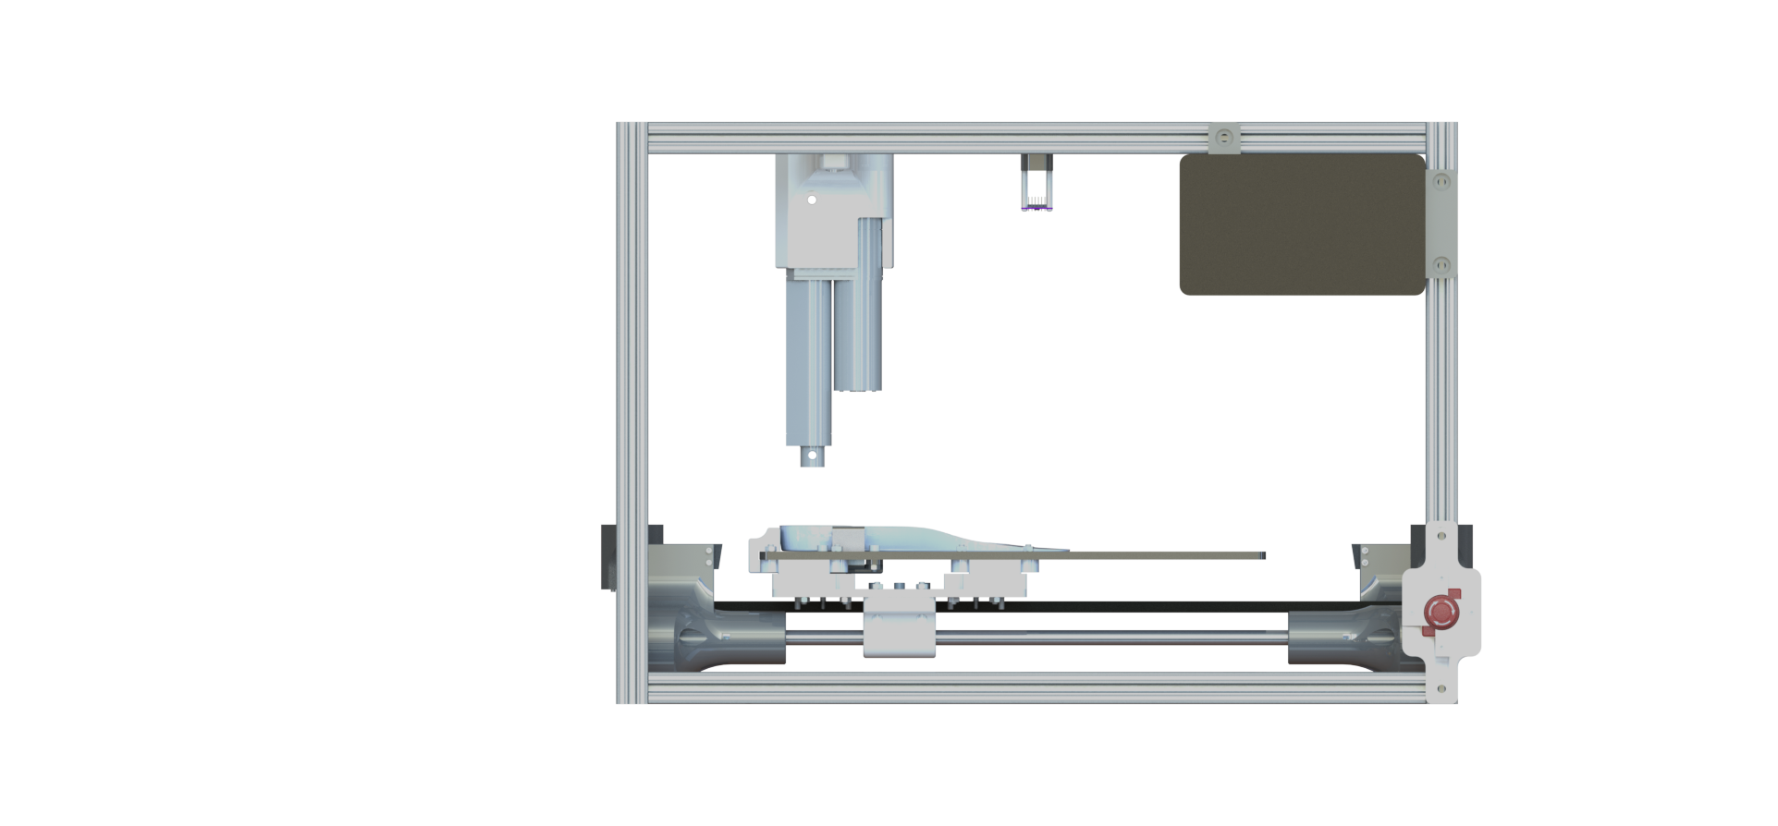
Mechanical Design
Centering Guides
Aluminum Extrusion Frame
DC Driving Motors
Allows consistent centering of insole
Allows for weight savings and easy reproducibility
Allows for precise and simple control
Polycarbonate Sheet Bed
Touch Screen Control
Rail & Belt Bed Movement
Allows for color choice and easy manufacturing/mounting
Allows for customization of UI and ease of operation
Allows for smooth, silent, and precise movement
Notes:
Mandy

Slide 8
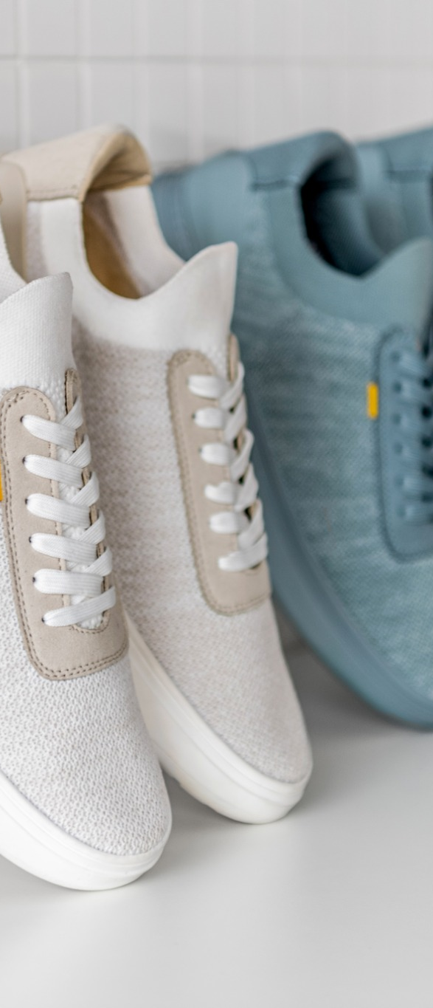
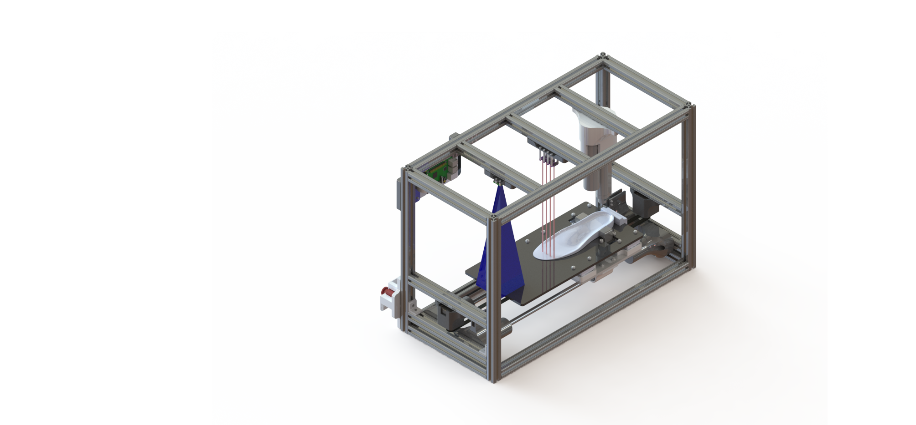
Mounted Sensors
Length Measuring Camera
Allows measurement of the insole length using pixel per length ratio
ToF Sensors Array
Allows for the measurement of arch height at specific coordinates
Linear Actuator
Compresses the heel to test for under extrusion
Weight Measuring Load Cells
4 load cells mounted in a Wheatstone circuit allow to measure the weight of the insole
Notes:
Mandy

Slide 9
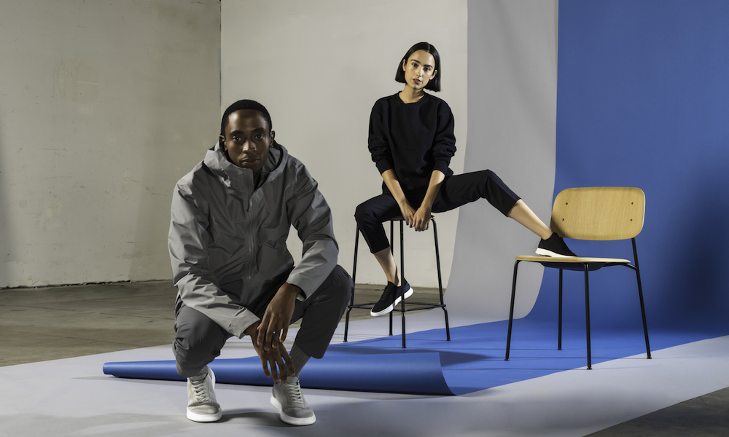
Validation Solutions

Slide 10
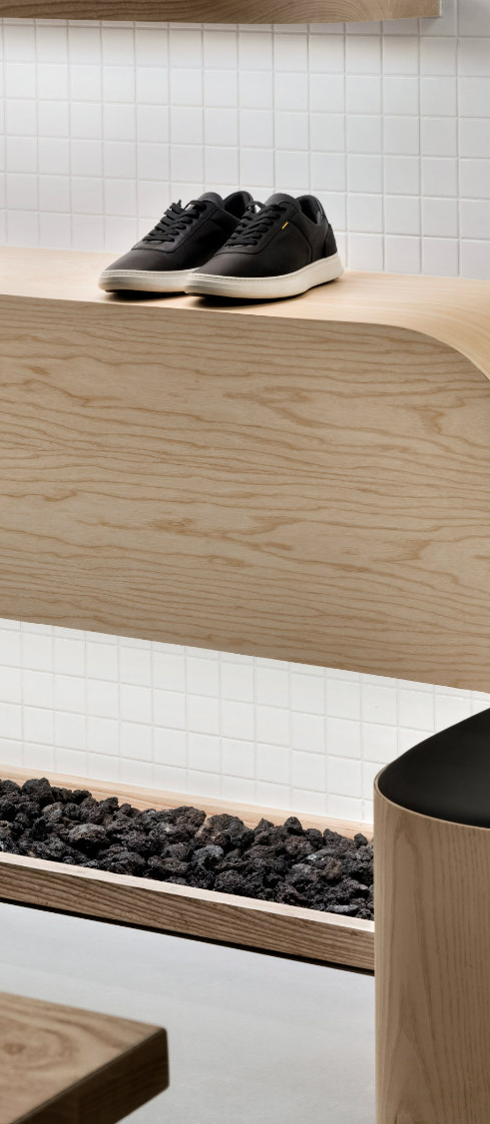

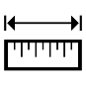
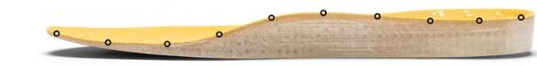

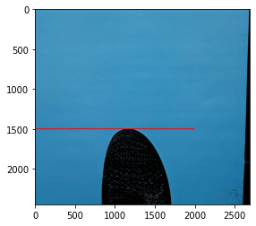

Length Validation Logic
Obtaining the sole length from a picture frame (OpenCV)
Finds the length of the insole in the frame of the picture by finding the last pixels of the sole color
Bottom of the frame is a known distance away from the heel block
Measured
Known
This requires the insole and the bed to have different colored surfaces
The measured length is then compared to the expected length from the database fetch
Notes:
Beni

Slide 11


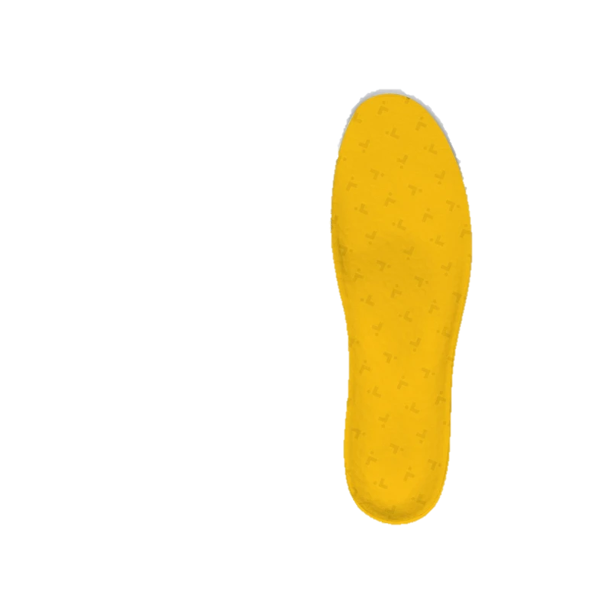
(NEW) Orientation Validation Logic
API Fetch
OpenCV Algorithm
Retrieve insole data API returns the orientation of a specific insole (L/R)
Determines whether the insole is a left or right depending on the largest distance from centerline
The outside of the sole will always have the largest measurement from the centerline
Notes:
Beni

Slide 12
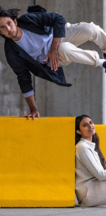



Weight Validation Logic
Theoretical
Experimental
1
2
1
Extruded Volume
2
Volume to Weight
Measured Weight
The extruded volume is fetched from the database using the APIs
The weight of the insole is calculated by multiplying the volume of the print by the density of TPU
The weight of the real insole is measured using the load cells mounted on the rig. The load cells act as a scale and their output is converted to a weight.
The strain in the load cell from an applied force produces an electrical resistance . When the 4 load cells are connected in a Wheatstone circuit, the total weight can be determined by measuring the voltage across the cells and converting it to a weight.
Notes:
Johnson

Slide 13
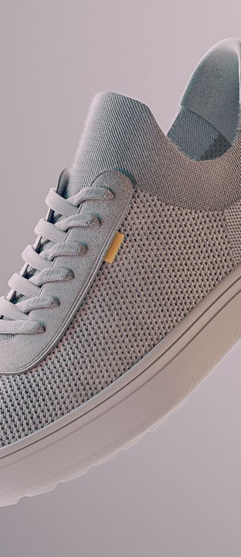
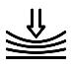
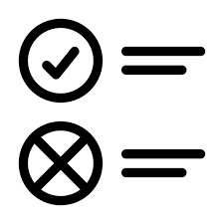
Compression Validation Logic
Compression Algorithm
Validation Algorithm
A linear actuator is used to get a compression reading at the heel of the sole
The mean force is compared to an experimental set of results and has to be correct within a certain margin of error
The compression occurs at a fixed displacement. The force applied is then measured
An average of 50 readings are used to account for variability in results
The experimental set of results will be conceived with the rig when it is complete and will correlate the applied force on the heel at a specific displacement with respect to the street size of the insole.
Notes:
Johnson

Slide 14
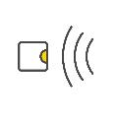

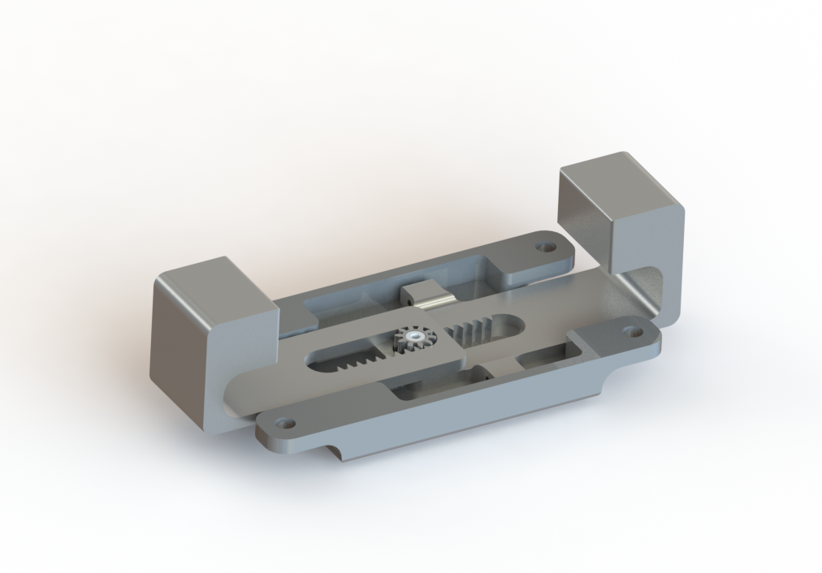
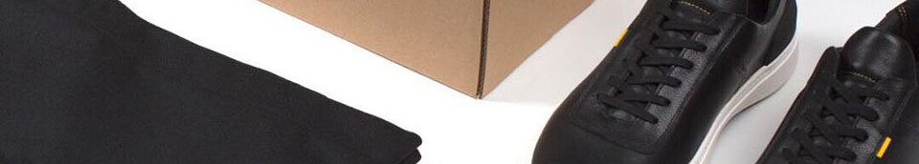
Arch Profile Validation Logic
Experimental
vs.
Theoretical
The ToF sensors can remain in place as the insole is guaranteed to be centered due to the included centering guides
Time of Flight Sensors
Python .STL Library
Position of ToF sensors known with respect to the heel and centerline of the insole
Using an .STL python library, able to calculate the surface height at the same coordinates as the ToF sensors
ToF sensors obtain height measurements at the known coordinates
Notes:
Mandy

Slide 15
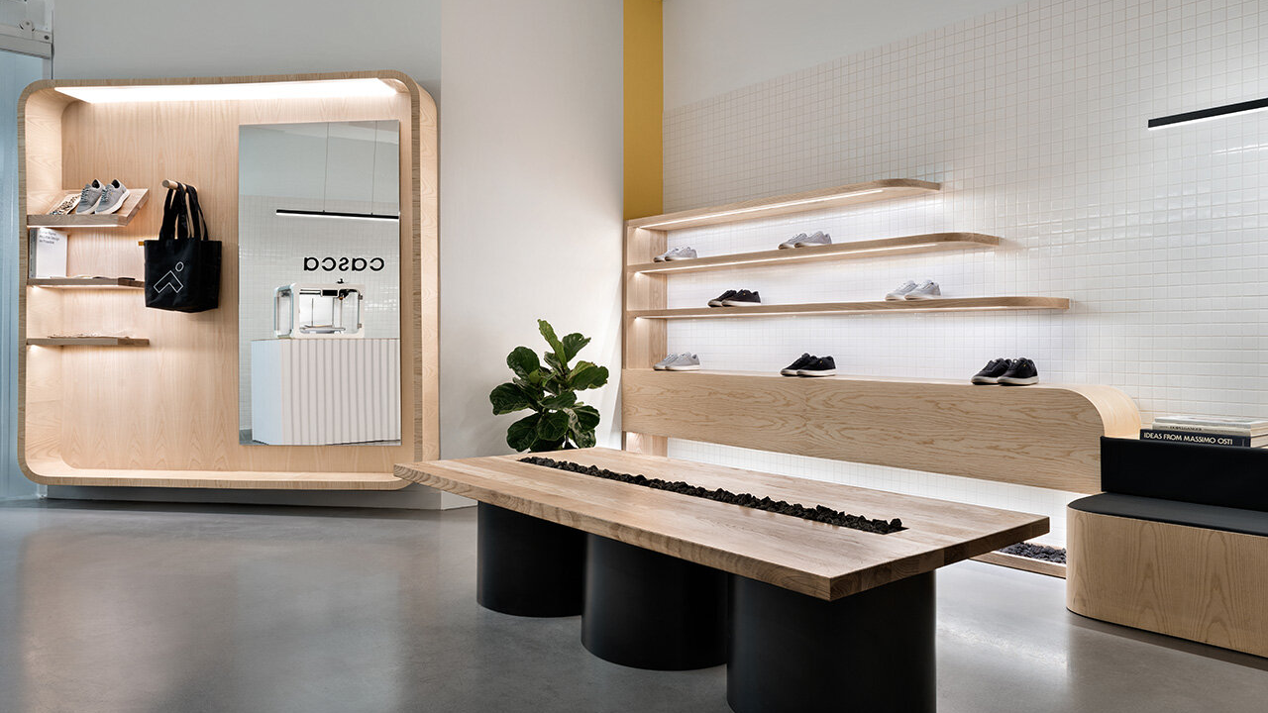
Architecture and UI

Slide 16

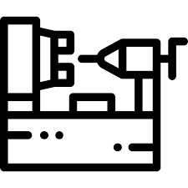




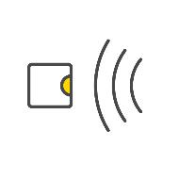

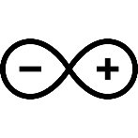








Project Architecture
Quality Control Rig
Databases
Buckets
Camera
TOF Sensors
Control Screen
Data
Scale
Arduino
Raspberry Pi
REST APIs
Print jobs and status’
Actuator
Bed Movement
Computations
API Library
3D Printers
Rig Actuation
Process Control
Notes:
Karl

Slide 17
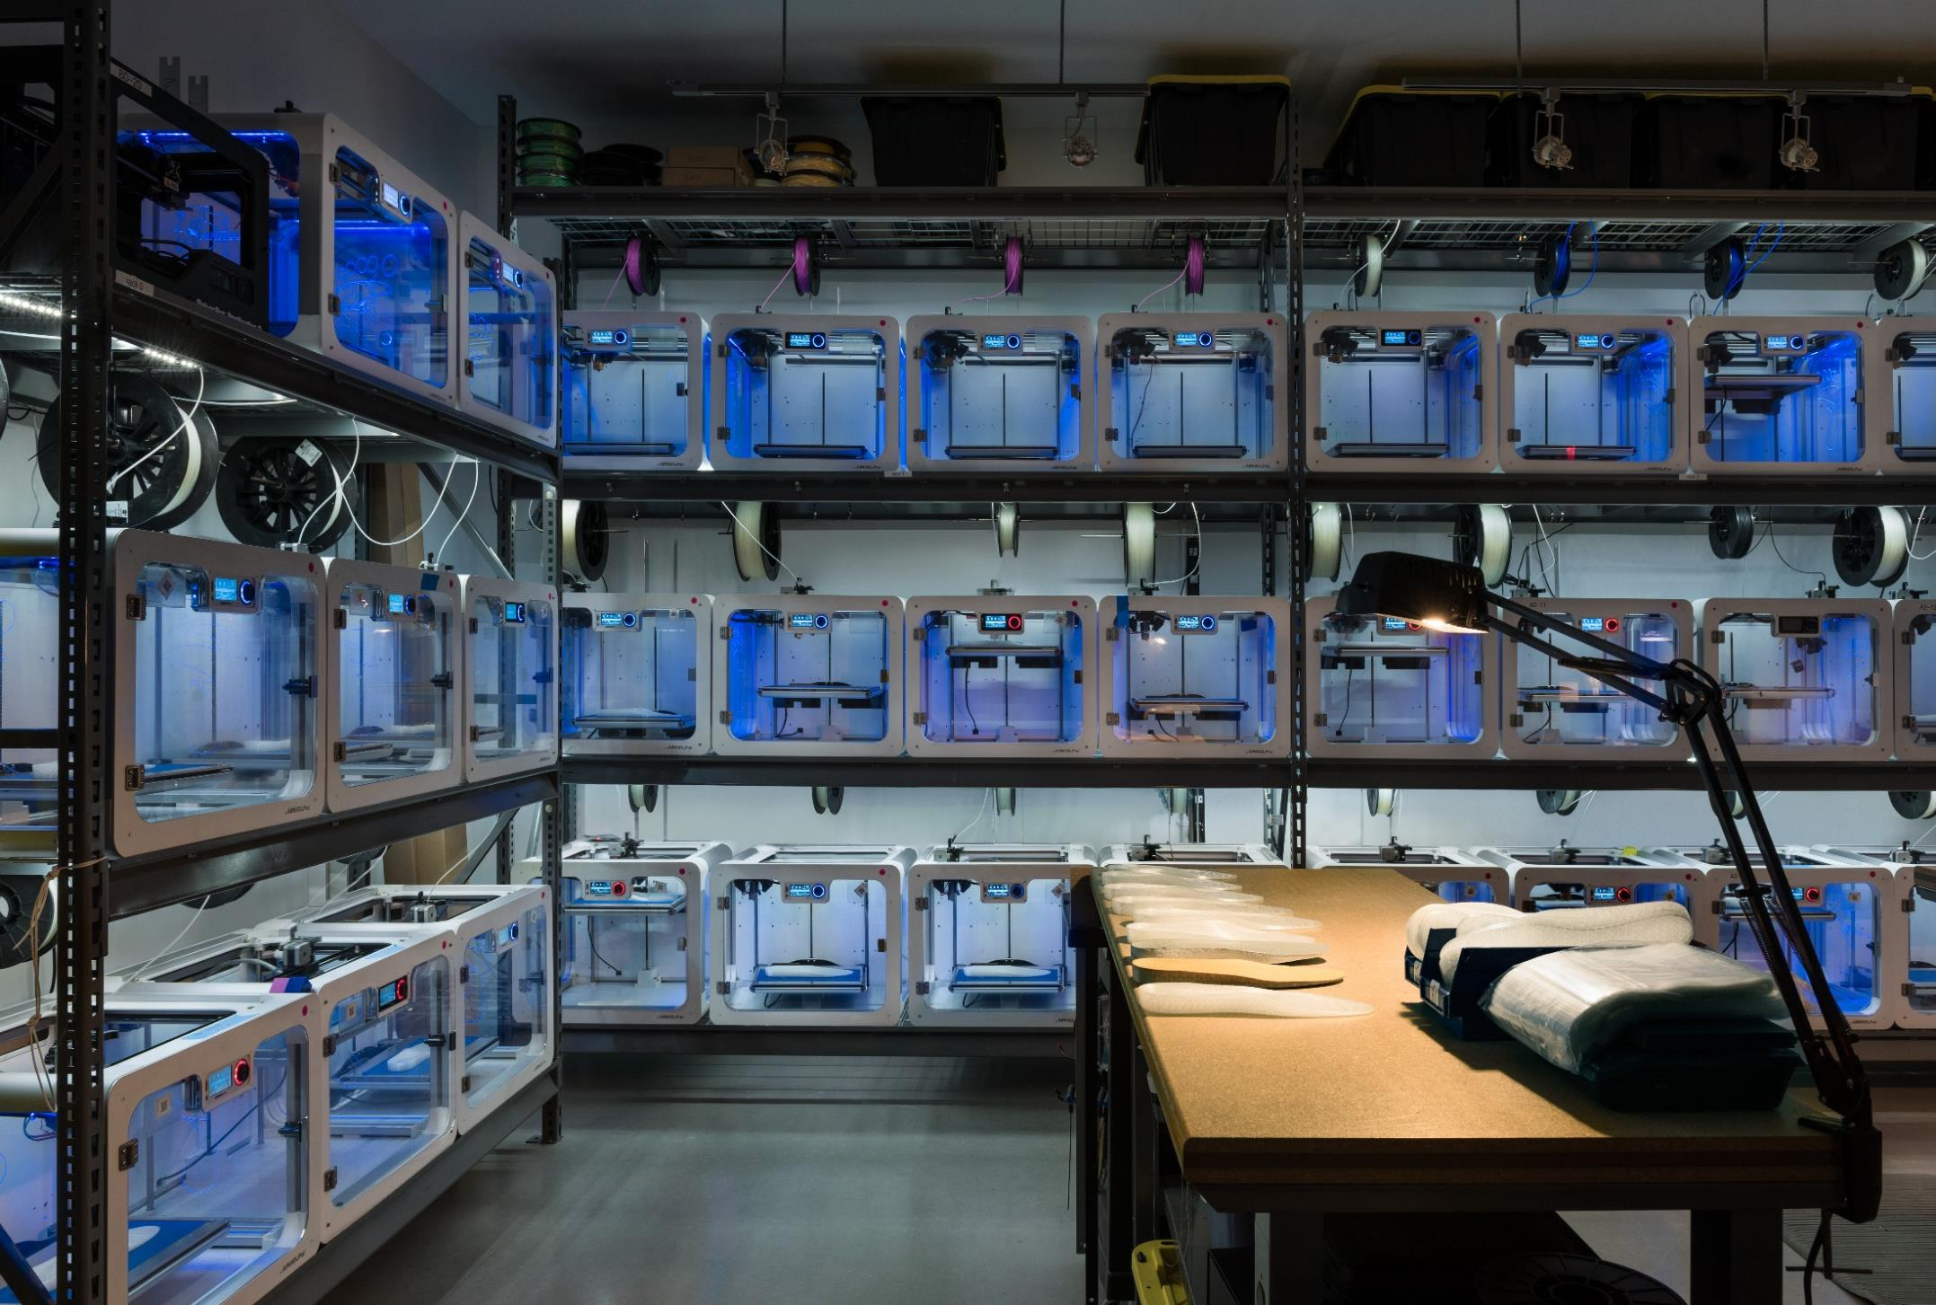
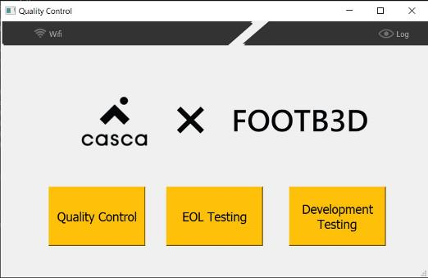
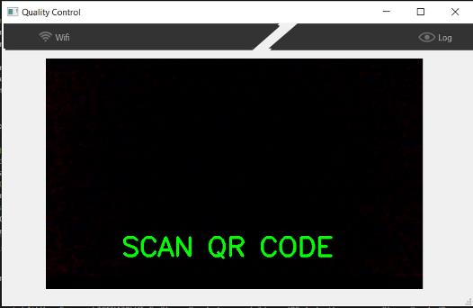
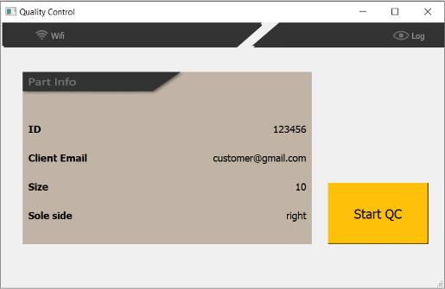
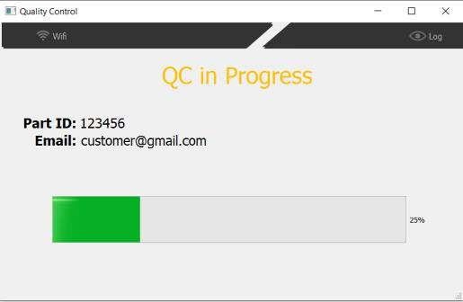
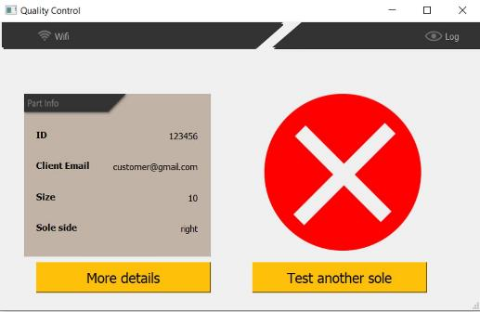
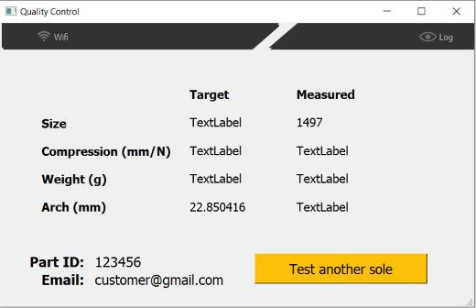
Control Screen User Interface
Start screen possesses options for the testing type
Scanning screen shows a live feed from the scanning camera
Confirmation screen as for user confirmation of the sole details
During QC, progress is shown with the above progress bar
The result of the test is shown after completion
Additional information can be displayed at the user’s request
Notes:
Beni

Slide 18
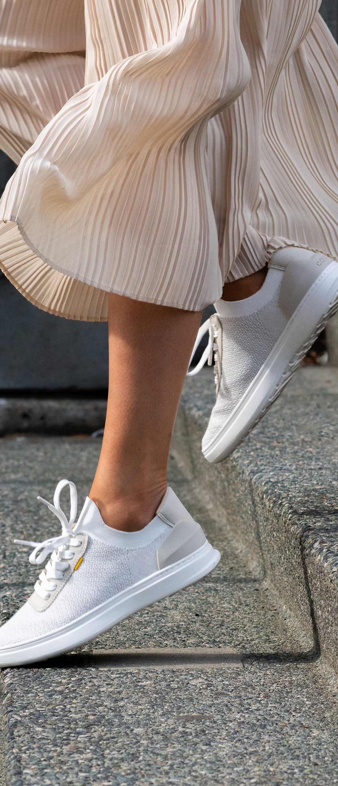











Leveraged Technology
Hardware
Programming languages
Python packages
Database tools
Notes:
Beni

